Slide 1

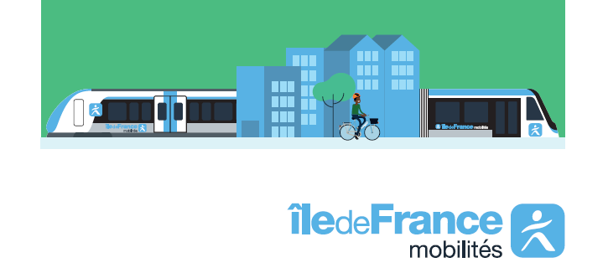
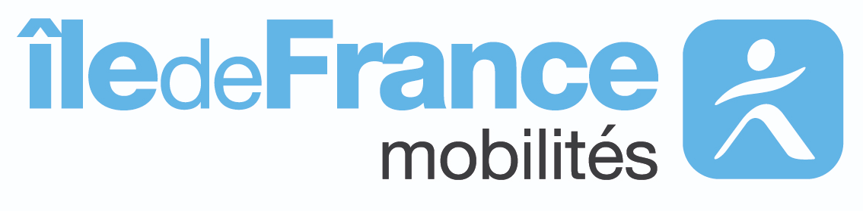
Ile-de-France Mobilités (Aa3 Stable / AA- Negative) :
Organising Authority for Public Transport
and Sustainable Mobility in Ile-de-France
December 2024
Notes:
Hello, I’m XXXXXXX of IDFM and I introduce you IDFM

Slide 2
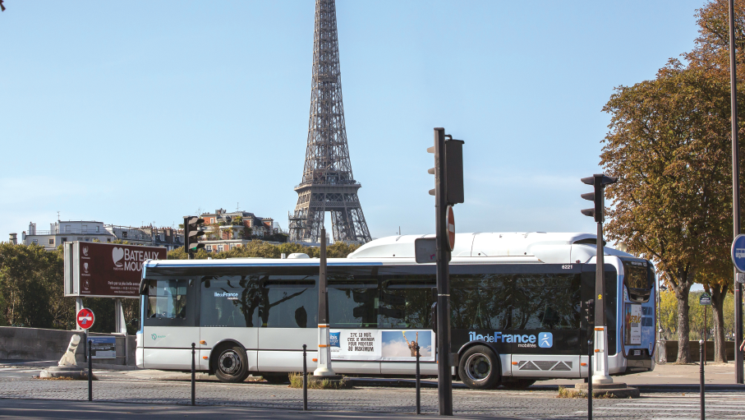

Slide 3

Contents
01. Ile-de-France Mobilités’ missions, scope of operations and governance
02. A strong financial situation
03. Ile-de-France Mobilités' Green Bond program
Notes:
Wa propose you to introduce IDFM’ missions and its financial accounts and after the framework

Slide 4
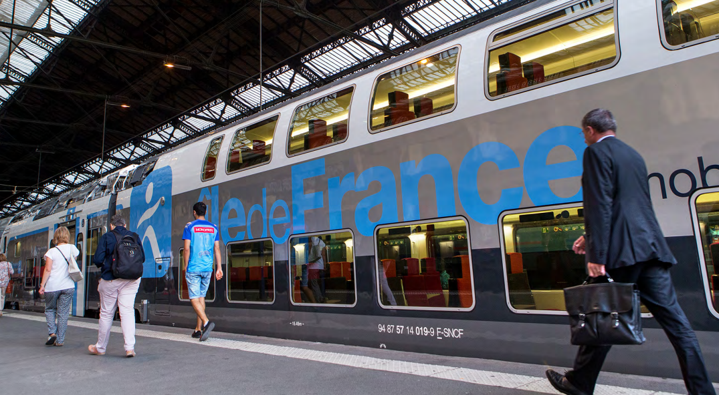
01
Île-de-France Mobilités’ missions, scope of operations, and governance

Slide 5
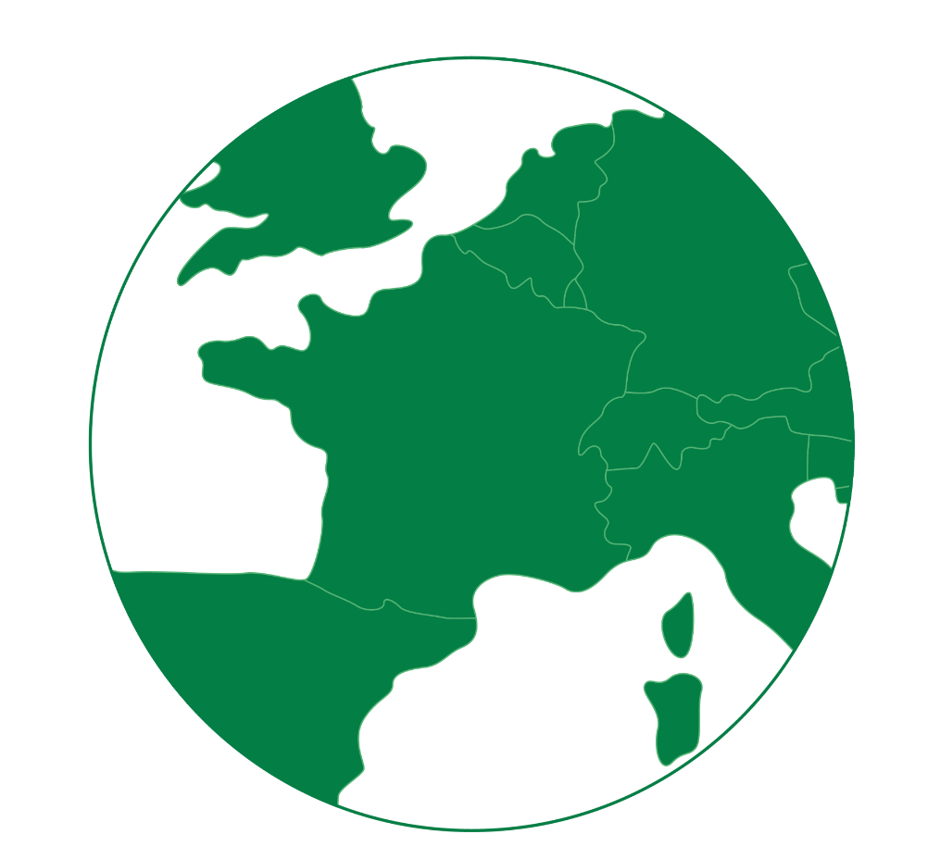
01. Île-de-France Mobilités’ missions, scope of operations and governance
Île-de-France key figures
  12.4 million inhabitants (almost 20% of the French population)
  6.4 million jobs
  30% of French GDP
  12,000 km²
  51 million visitors
  Europe's first employment area
  43 millions trips per day (including 9,4 million in public transport)
Investor presentation 2024

Slide 6
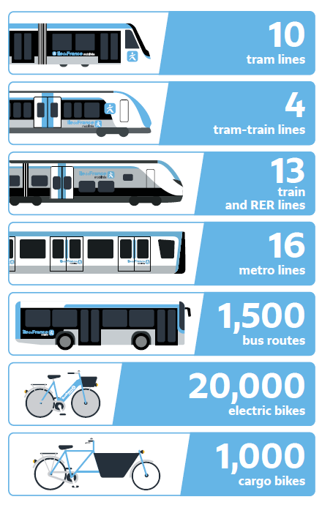
01. Île-de-France Mobilités’ missions, scope of operations and governance
Île-de-France Mobilités is the integrated public transport authority
Designs and decides
Organises
Finances
the operation and modernisation of the public transport system
modernises the transport network and builds new lines
entrusts the operation of the network to transport companies by setting objectives
creates the passes and tickets and sets the fares
projects to improve the public transport system
Île-de-France Mobilités
Investor presentation 2024

Slide 7













01. Île-de-France Mobilités’ missions, scope of operations and governance
Mobility : who is responsible for what ?
 | Transport companies |  | French State and local authorities
Finances all the investments (rolling stock, modernisation of the transport system) except the cost of new lines Finances the operating costs of the regional transport system | Operate the transport system Order the rolling stock on behalf of Île-de-France Mobilités | Designs, builds and finances the Grand Paris Express lines and stations Orders the rolling stock on behalf of Île-de-France Mobilités | Finances new lines except the Grand Paris Express Participates in the financing of Île-de-France Mobilités (local authorities only)
(and others…)
(and others…)
Investor presentation 2024

Slide 8
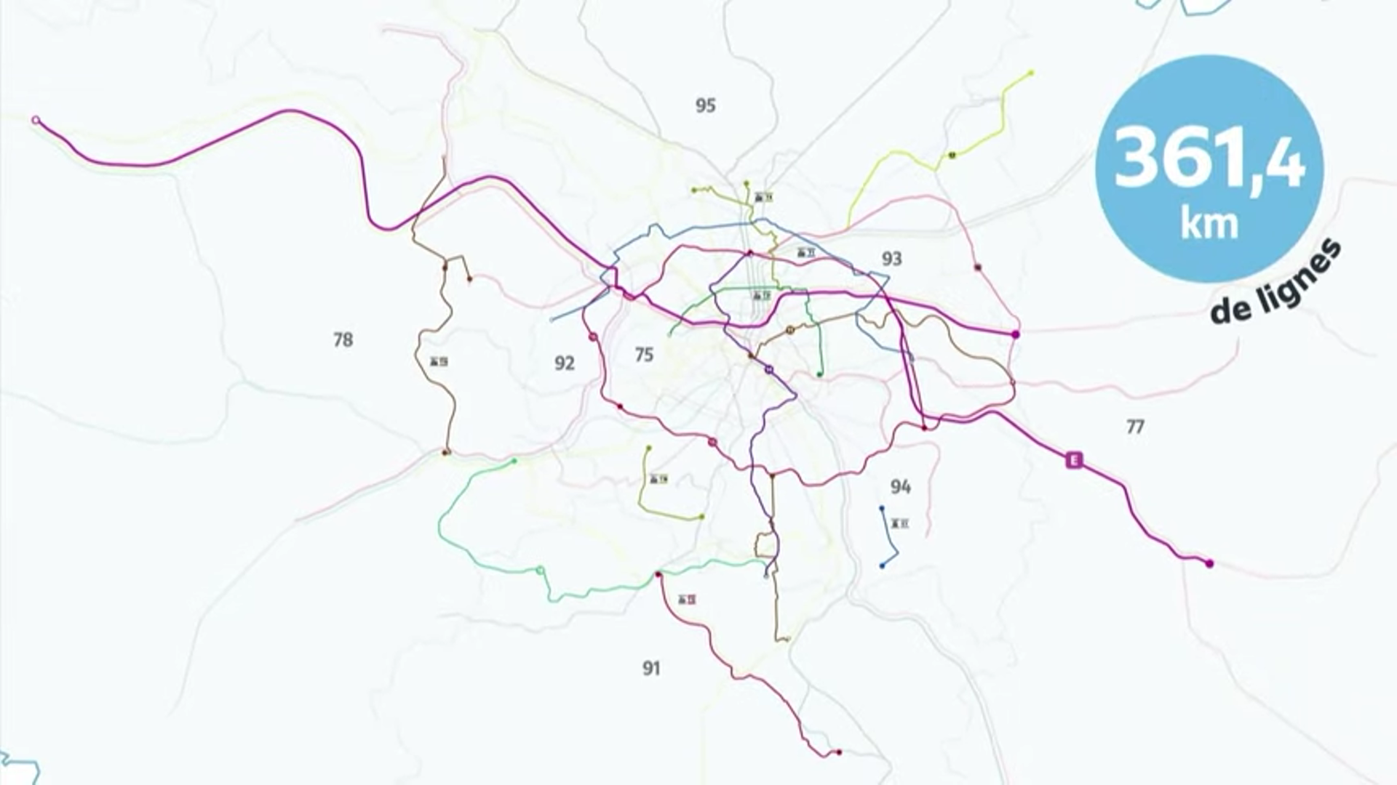
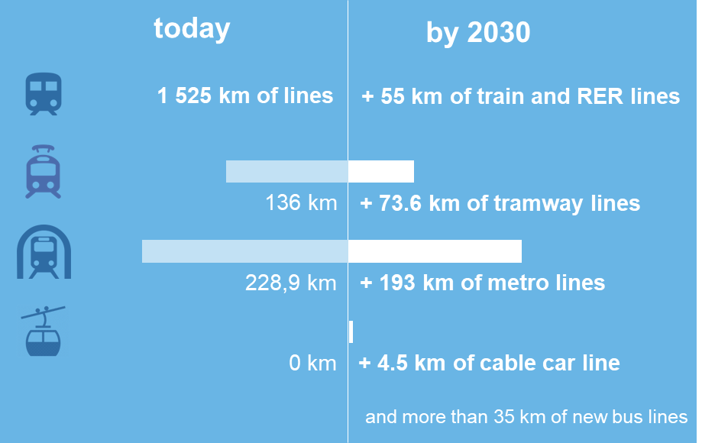
01. Île-de-France Mobilités’ missions, scope of operations and governance
Our network, which is the 2nd densest one in the world, will expand significantly by 2030
+
Investor presentation 2024

Slide 9
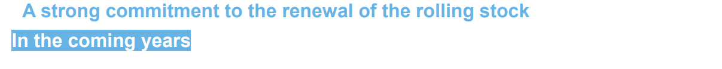
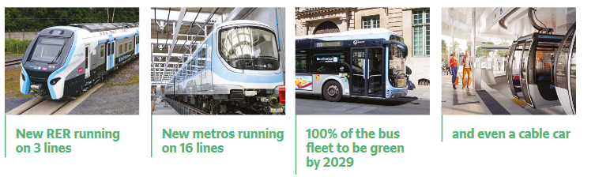
01. Île-de-France Mobilités’ missions, scope of operations and governance
Investor presentation 2024

Slide 10
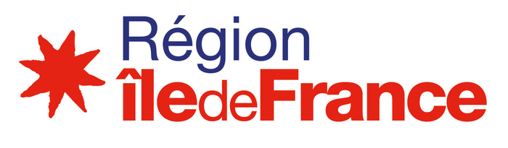

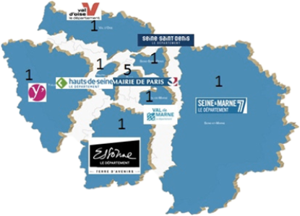
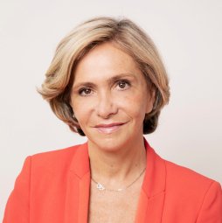
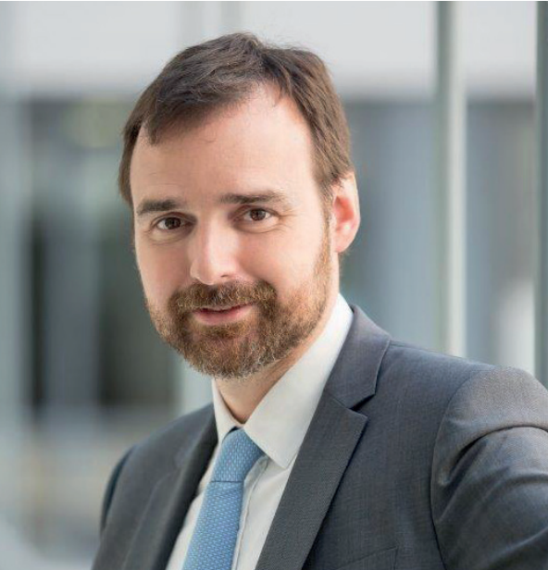
01. Ile-de-France Mobilités’ missions, scope of operations and governance
Governance
A council of 31 members, presided by Île-de-France’s regional council president :
: 16 representatives
Valérie PECRESSE
Ile-de-France Mobilités’
President
Laurent PROBST
Ile-de-France Mobilités’
Chief Executive
+ 3 representatives of :
intermunicipal cooperation bodies,
the Regional Chamber of Commerce and Industry,
users associations.
Investor presentation 2024
Notes:
31 members compose the board of executives, among which :
The région IDF which is in the majority
Paris
And the 7 departments of IDF
2 members representing local intermunicipalities, as public transport concern their territories as well, and the Chamber of Commerce and Industry, as public transportation plays a key role in the local economy.
Since 2020 : 1 member representing associations users
The 9 local authorities are required, as members, to pay statutory contributions to IDFM. The amount of these yearly contributions is decided by IDFM’s board of executives. The share due by each local authority relies on IDFM’s status : 51% for the Région IDF, 30% for the city of Paris and 19% dispatched among the 7 departments.
IDFM a 100% public local administration (EPA) with an independent and stable governance since 2005. Ile-de-France Mobilités must respect financial rules :IDFM is not able to approve an unbalanced budget or be in a « bankruptcy » position. We are controlled by a public audit authority
for all these reasons (strong operating environment, added to the economic growth of the area, the importance of IDFM and its past successful financial negotiations with the Government), led Moody’s to let unchanged its long and short term rating, Aa2 /P-1, in July 2020

Slide 11



Environmental, Social, and Economic Impacts of Public Transport
03. Île-de-France Mobilités Environmental and Social Strategy
Environmental Impact
Social Impact
Economic Impact
25% to 30%
reduction in greenhouse gas emissions from transport in Île-de-France between 2019 and 2030
90%
of pass Navigo holders receive a refund
100,000 direct jobs
created nationally thanks to Île-de-France Mobilités
Aligned with the national target set for the transport sector in the National Low Carbon Strategy (SNBC 2, 2020).
Aligned with the transport component of the National Ecological Planning (2023), which aims to translate the "Fit for 55" target set by the European Union of a 55% reduction in GHG emissions in 2030 compared to 1990.
All of these objectives are aligned with a trajectory to achieve carbon neutrality by 2050.
90% of subscribers benefit from an employer reimbursement between 25% and 100%, depending on the employers' coverage.
Fare structure that includes many reduced rates: half of the holders of a 12-month pass benefit from a reduced rate (Améthyste, Imagine R (Schoolchild, Student, Junior), etc.).
Some users benefit from free transport: beneficiaries of the RSA, children under the age of 4, etc.
100,000: estimated number of direct jobs created by this sector (2023 study).
¾ of these jobs concern operations activities
¼ of these jobs concerns investment-related activities: extension of the network, its maintenance, or rolling stock.
Powerful spillover effects on the other sectors that revolve around it (new mobility, real estate, low-carbon energy, etc.).
Investor presentation 2024
Notes:
A positive impact on pollution levels:
-13% : evolution of CO₂ emission between 2010 and 2019 from road transportation
-32% : evolution NOx gas emission between 2010 and 2019 from road transportation
-17% : evolution PM10 gas emission between 2010 and 2019

Slide 12
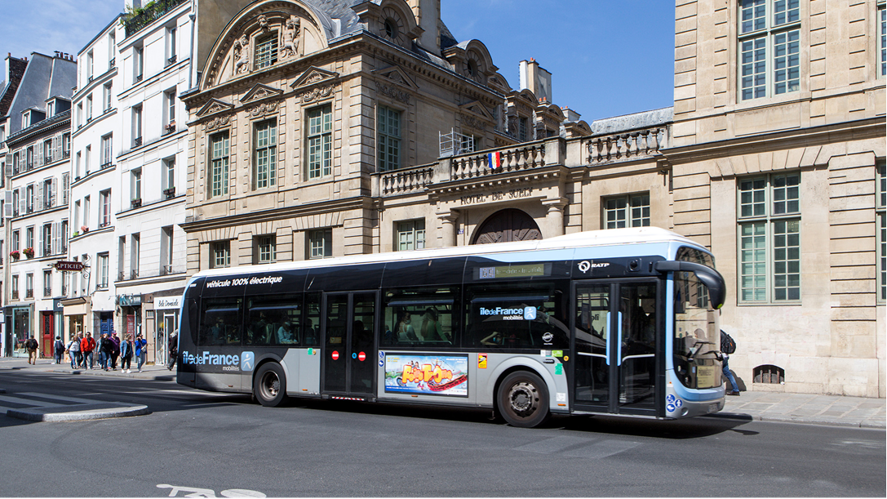
Our strong
financial situation
02

Slide 13




02. Our strong financial situation
Status and financial rules
IDFM is a 100% public local administration (EPA).
Ile-de-France Mobilités is subject to budgetary rules that applies to French local authorities with the control of its actions by the State (through the State representative in Île-de-France) and by a financial court that is independent of the public authorities (regional chamber of accounts).
These rules protect taxpayers' money and the interests of Île-de-France Mobilités investors.
Ile-de-France Mobilités :
Cannot go bankrupt or undergo liquidation proceedings | Is compelled to approve a balanced operating budget | Cannot borrow to finance OPEX | Must repay debt interests and capital on their own resources
Investor presentation 2024
Notes:
31 members compose the board of executives, among which :
The région IDF which is in the majority
Paris
And the 7 departments of IDF
2 members representing local intermunicipalities, as public transport concern their territories as well, and the Chamber of Commerce and Industry, as public transportation plays a key role in the local economy.
Since 2020 : 1 member representing associations users
The 9 local authorities are required, as members, to pay statutory contributions to IDFM. The amount of these yearly contributions is decided by IDFM’s board of executives. The share due by each local authority relies on IDFM’s status : 51% for the Région IDF, 30% for the city of Paris and 19% dispatched among the 7 departments.
IDFM a 100% public local administration (EPA) with an independent and stable governance since 2005. Ile-de-France Mobilités must respect financial rules :IDFM is not able to approve an unbalanced budget or be in a « bankruptcy » position. We are controlled by a public audit authority
for all these reasons (strong operating environment, added to the economic growth of the area, the importance of IDFM and its past successful financial negotiations with the Government), led Moody’s to let unchanged its long and short term rating, Aa2 /P-1, in July 2020

Slide 14
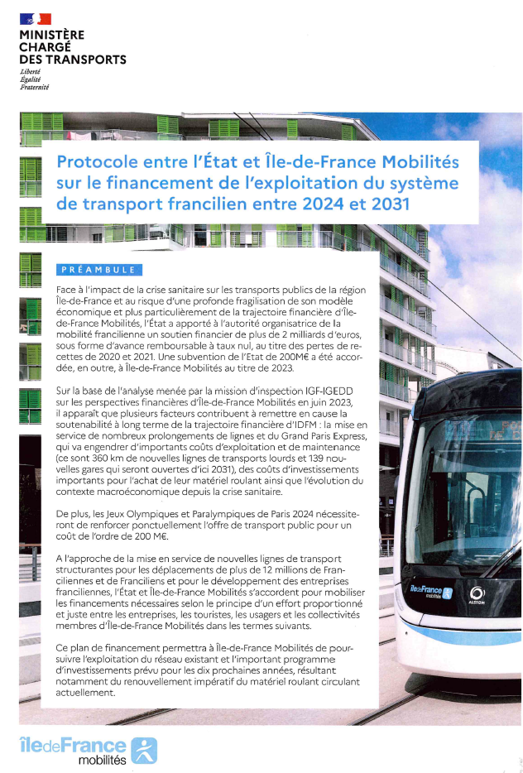
02. Our strong financial situation
Landmark deal with the French State to allocate new resources to Ile-de-France Mobilites signed in 2023
  VM - rates increased by 0.25 points in central and inner suburbs (+400 M€)Tourist tax - Regional additional tax (TAR) increased by 200% (+200 M€)
Taxation
The signing of a financing agreement with the Minister of Transport on September 26, 2023 concluded 3 years of regular exchanges with the French government
This agreement is based on a fair and shared effort between all the funding parties, aimed at maintaining the current funding balance for public transport in the Paris region for the current decade
The 2024 budget therefore includes the additional resources set out in the protocol
Users
  Rates to rise in line with inflation in 2024. Increase in line with inflation +1 point thereafter
Local authorities
  Contributions increase in line with inflation + 2 points from 2024 to 2028
  Inflation thereafter
Expenditure control
  GPE operating fees halved
Investor presentation 2024
*AIE : Actual Investment Expenses
Notes:
and to finish this part, slide 17, The first graph shows the evolution of the IDFM debt
Benefitting from dynamic revenues Ile-de-France Mobilités did not have to start borrowing until 2012.
Due to an acceleration in investments, borrowing became a necessity, the first lender was EIB.
We rapidly diversified our financing sources with others banks.
In 2018, IDFM launched its EMTN program and issued its inaugural bond in April 2019 (benchmark at 15yrs. More than 2.3bn EUR of interests were collected from around 70 investors. )
In 2021, Ile de France Mobilités continues to diversify its sources of financing with bank loans for 550 M €, 2 private placements for 155 M € and the green bond issue for 1500 M € in May and November. More than 3.1bn EUR of interests were collected from around 115 investors.
The second graph shows the evolution of ratios
the green curve shows the investments self financing ratio
The blue curve shows the deleveraging capacity. it indicates how many years of income are needed to repay the outstanding debt. it is 4 years; which is very low
these two ratios reach good levels in 2020 despite the crisis.
In 2021, IDFM will cover its financing needs mainly with a Green Bond and secondarily with other sources of financing (commercial banks and private placements)
(In 2016, Ile de France’s deleveraging capacity bounced following the instauration of a single flat fare, exceptionally covered by provisions write-offs, whereas provisions write-offs are not taken into account in this ratio. The latter returned to a performant level from 2017 onward, when IDFM found new revenues in order to cover this measure. In 2019, the deleveraging capacity reaches 4 years.)

Slide 15
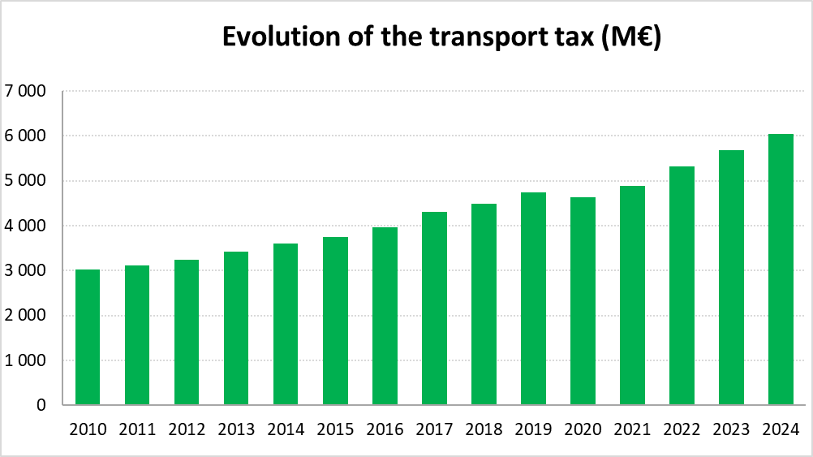
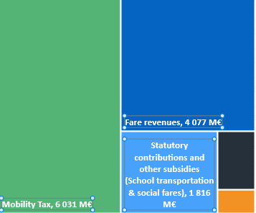
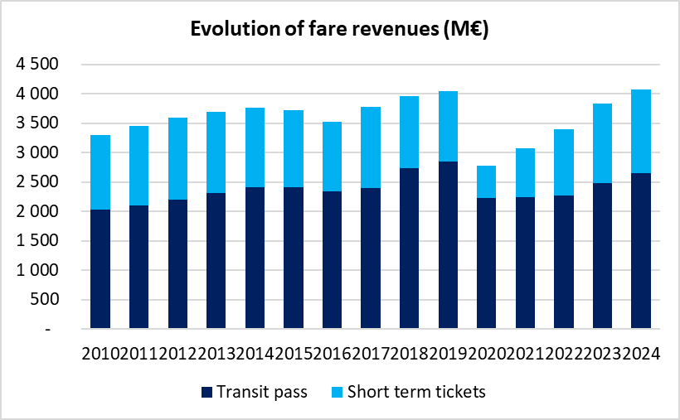

02. Our strong financial situation
How it works: financing operations
2024 - Operating section balances forecast
In 2024, Ile-de-France Mobilités’ actual operating revenues are expecting to reach 12,6 bn€.
Mobility tax : + 3,4%
Tourist Tax : 200 M€
12 624 M€
Other: 500 M€
Investor presentation 2024
Notes:
We will begin with an overview of public transports’ exploitation costs and the way they are financed
On the slide 12, you can see that the Total cost of transport operation amounts to more than 10,7 Bn€ in 2020
There are 3 main income sources:
Transport tax 4,6 bn€
France is the only European country to tax employers in areas that have a public transport network. This local tax is dedicated to the Organising Authority, in order to fund public transportation.
This tax is based on aggregated payroll of each employer having more than 11 employees. As a consequence, this revenue depends on local job creations and on the level of salaries granted by employers.
The applicable rate depends on the location of employees’ workplace.
- Secondly, Fare revenues about 3bn€ include the price paid by passengers, part of the subscriptions paid by the employers and some public subsidies for social fares.
Finally, Public subsidies: 1,9 bn€ paid by local authorities members of IDFM or French state for school transport
In the end travellers pay only 18% of the resources, a very low rate compared to our European neighbors, and employers pay 50%
These 10,7 bn € enable us to pay the transport operators (among with RATP, SNCF…) and contribute to our investment expenditures
The two main sources of transport funding are strongly correlated to regional economic growth.
Important point : 30% of national GDP is produced on Ile de France territory. Considering that public transports are the main means of transportation for 43% of working people in the area, IDFM has a keyrole in the local and the national economy by extension. For this reason, IDFM benefits from an implicit support from the State. This enables IDFM to negogiate transport tax rates hikes and new resources, when necessary. By exemple:
In 2017, A new tax on petroleum products sold within the region, for 100 M€/year, to finance « single fare” measure on Transit Pass. (To finance a based on the « polluter pays » principle)
Or an increase in rates of transport tax (Following this decision made by IDFM previous elected team. To compensate this measure, the current President negotiated new resources with the State (450 M€ in all))
Transport tax :
France is the only European country to tax employers in areas that have a public transport network. This local tax is dedicated to the Organising Authority, in order to fund public transportation.
This tax is based on aggregated payroll of each employer having more than 11 employees. As a consequence, this revenue depends on local job creations and on the level of salaries granted by employers.
The applicable rate depends on the location of employees’ workplace.
IDFM decides upon rates for each zone within limits fixed for each zone by financial laws. (The rates currently applied are those fixed by the last financial law for 2018. This law led to a 0.21% hike/year in rates for zone 2 from 2018 till 2021.)
Since 2011, IDFM has always managed to negogiate rates’hikes with the State. As a result, revenues grew by 53% between 2010 and 2020.
Fare revenues :
Are strongly related to tourism (for short term tickets : 35% of fare revenues since 2016) and employment or student (for pass : 65% of fare revenues since 2016).
IDFM decides on rates
Based on a solid regional environment, fare revenues have been constantly growing these last years, except on 2020 because of impact of health crisis
(with two exceptions :
2016 was the 1st year of full impact of the “single fare” measure on Transit Pass. Following this decision made by IDFM previous elected team. To compensate this measure, the current President negotiated new resources with the State (450 M€ in all) and proposed to the board of executive to vote for price increases in 2016 as well as in 2017. )

Slide 16
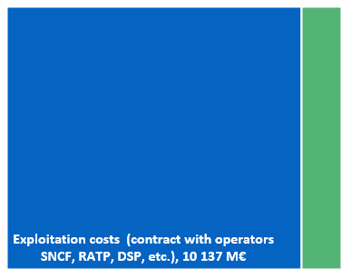
02. Our strong financial situation
How it works: financing operations
2024 - Operating section balances forecast
In 2024, Ile-de-France Mobilités’ actual operating expenditures are expecting to reach 11,5 bn€.
Exploitation costs
It includes :
- Contract with SNCF : 3 803 M€
- Contract with RATP : 5 138 M€
- Contract with CT3/DSP : 1160 M€
- SGP : 36 M€
Other : 1 383 M€
It includes :
- School Transportation : 193 M€
- Running charges and financial fees : 460 M€
- Social Tarification : 7,9 M€
- Other (Olympic Game, subsidiary, ticketing, Veligo etc.) : 447 M€
11 520 M€
Investor presentation 2024
Notes:
We will begin with an overview of public transports’ exploitation costs and the way they are financed
On the slide 12, you can see that the Total cost of transport operation amounts to more than 10,7 Bn€ in 2020
There are 3 main income sources:
Transport tax 4,6 bn€
France is the only European country to tax employers in areas that have a public transport network. This local tax is dedicated to the Organising Authority, in order to fund public transportation.
This tax is based on aggregated payroll of each employer having more than 11 employees. As a consequence, this revenue depends on local job creations and on the level of salaries granted by employers.
The applicable rate depends on the location of employees’ workplace.
- Secondly, Fare revenues about 3bn€ include the price paid by passengers, part of the subscriptions paid by the employers and some public subsidies for social fares.
Finally, Public subsidies: 1,9 bn€ paid by local authorities members of IDFM or French state for school transport
In the end travellers pay only 18% of the resources, a very low rate compared to our European neighbors, and employers pay 50%
These 10,7 bn € enable us to pay the transport operators (among with RATP, SNCF…) and contribute to our investment expenditures
The two main sources of transport funding are strongly correlated to regional economic growth.
Important point : 30% of national GDP is produced on Ile de France territory. Considering that public transports are the main means of transportation for 43% of working people in the area, IDFM has a keyrole in the local and the national economy by extension. For this reason, IDFM benefits from an implicit support from the State. This enables IDFM to negogiate transport tax rates hikes and new resources, when necessary. By exemple:
In 2017, A new tax on petroleum products sold within the region, for 100 M€/year, to finance « single fare” measure on Transit Pass. (To finance a based on the « polluter pays » principle)
Or an increase in rates of transport tax (Following this decision made by IDFM previous elected team. To compensate this measure, the current President negotiated new resources with the State (450 M€ in all))
Transport tax :
France is the only European country to tax employers in areas that have a public transport network. This local tax is dedicated to the Organising Authority, in order to fund public transportation.
This tax is based on aggregated payroll of each employer having more than 11 employees. As a consequence, this revenue depends on local job creations and on the level of salaries granted by employers.
The applicable rate depends on the location of employees’ workplace.
IDFM decides upon rates for each zone within limits fixed for each zone by financial laws. (The rates currently applied are those fixed by the last financial law for 2018. This law led to a 0.21% hike/year in rates for zone 2 from 2018 till 2021.)
Since 2011, IDFM has always managed to negogiate rates’hikes with the State. As a result, revenues grew by 53% between 2010 and 2020.
Fare revenues :
Are strongly related to tourism (for short term tickets : 35% of fare revenues since 2016) and employment or student (for pass : 65% of fare revenues since 2016).
IDFM decides on rates
Based on a solid regional environment, fare revenues have been constantly growing these last years, except on 2020 because of impact of health crisis
(with two exceptions :
2016 was the 1st year of full impact of the “single fare” measure on Transit Pass. Following this decision made by IDFM previous elected team. To compensate this measure, the current President negotiated new resources with the State (450 M€ in all) and proposed to the board of executive to vote for price increases in 2016 as well as in 2017. )

Slide 17
02. Our strong financial situation
How it works: financing operations
2024 - Investment section balances forecast
Other
854 M€
Rail Rolling Stock
1 678 M€
In 2024, Ile-de-France Mobilités’ actual investment expenditures are expecting to reach 4,5 bn€.
SNCF depot
162 M€
Multiproject SNCF
185 M€
These expenses are financed by :
- Up to 53% with borrowings : 2,4 bn€ of debt to be raised in 2024
- Up to 47% with own resources (gross saving, subsidies, parking fines)
Bus depot
214 M€
Infrastructures
223 M€
Quality of service
450 M€
Pay back of debt
306 M€
Surface Rolling Stock
430 M€
Investor presentation 2024
Notes:
We will begin with an overview of public transports’ exploitation costs and the way they are financed
On the slide 12, you can see that the Total cost of transport operation amounts to more than 10,7 Bn€ in 2020
There are 3 main income sources:
Transport tax 4,6 bn€
France is the only European country to tax employers in areas that have a public transport network. This local tax is dedicated to the Organising Authority, in order to fund public transportation.
This tax is based on aggregated payroll of each employer having more than 11 employees. As a consequence, this revenue depends on local job creations and on the level of salaries granted by employers.
The applicable rate depends on the location of employees’ workplace.
- Secondly, Fare revenues about 3bn€ include the price paid by passengers, part of the subscriptions paid by the employers and some public subsidies for social fares.
Finally, Public subsidies: 1,9 bn€ paid by local authorities members of IDFM or French state for school transport
In the end travellers pay only 18% of the resources, a very low rate compared to our European neighbors, and employers pay 50%
These 10,7 bn € enable us to pay the transport operators (among with RATP, SNCF…) and contribute to our investment expenditures
The two main sources of transport funding are strongly correlated to regional economic growth.
Important point : 30% of national GDP is produced on Ile de France territory. Considering that public transports are the main means of transportation for 43% of working people in the area, IDFM has a keyrole in the local and the national economy by extension. For this reason, IDFM benefits from an implicit support from the State. This enables IDFM to negogiate transport tax rates hikes and new resources, when necessary. By exemple:
In 2017, A new tax on petroleum products sold within the region, for 100 M€/year, to finance « single fare” measure on Transit Pass. (To finance a based on the « polluter pays » principle)
Or an increase in rates of transport tax (Following this decision made by IDFM previous elected team. To compensate this measure, the current President negotiated new resources with the State (450 M€ in all))
Transport tax :
France is the only European country to tax employers in areas that have a public transport network. This local tax is dedicated to the Organising Authority, in order to fund public transportation.
This tax is based on aggregated payroll of each employer having more than 11 employees. As a consequence, this revenue depends on local job creations and on the level of salaries granted by employers.
The applicable rate depends on the location of employees’ workplace.
IDFM decides upon rates for each zone within limits fixed for each zone by financial laws. (The rates currently applied are those fixed by the last financial law for 2018. This law led to a 0.21% hike/year in rates for zone 2 from 2018 till 2021.)
Since 2011, IDFM has always managed to negogiate rates’hikes with the State. As a result, revenues grew by 53% between 2010 and 2020.
Fare revenues :
Are strongly related to tourism (for short term tickets : 35% of fare revenues since 2016) and employment or student (for pass : 65% of fare revenues since 2016).
IDFM decides on rates
Based on a solid regional environment, fare revenues have been constantly growing these last years, except on 2020 because of impact of health crisis
(with two exceptions :
2016 was the 1st year of full impact of the “single fare” measure on Transit Pass. Following this decision made by IDFM previous elected team. To compensate this measure, the current President negotiated new resources with the State (450 M€ in all) and proposed to the board of executive to vote for price increases in 2016 as well as in 2017. )

Slide 18
02. Our strong financial situation
Evolution of Ile-de-France Mobilités’ outstanding debt volumes
Moody’s :
Aa3, stable outlook
Fitch :
AA-, negative outlook
The deleveraging ratio reached 13,9 in 2022 and 7,2 in 2023
Investor presentation 2024
*AIE : Actual Investment Expenses
Notes:
and to finish this part, slide 17, The first graph shows the evolution of the IDFM debt
Benefitting from dynamic revenues Ile-de-France Mobilités did not have to start borrowing until 2012.
Due to an acceleration in investments, borrowing became a necessity, the first lender was EIB.
We rapidly diversified our financing sources with others banks.
In 2018, IDFM launched its EMTN program and issued its inaugural bond in April 2019 (benchmark at 15yrs. More than 2.3bn EUR of interests were collected from around 70 investors. )
In 2021, Ile de France Mobilités continues to diversify its sources of financing with bank loans for 550 M €, 2 private placements for 155 M € and the green bond issue for 1500 M € in May and November. More than 3.1bn EUR of interests were collected from around 115 investors.
The second graph shows the evolution of ratios
the green curve shows the investments self financing ratio
The blue curve shows the deleveraging capacity. it indicates how many years of income are needed to repay the outstanding debt. it is 4 years; which is very low
these two ratios reach good levels in 2020 despite the crisis.
In 2021, IDFM will cover its financing needs mainly with a Green Bond and secondarily with other sources of financing (commercial banks and private placements)
(In 2016, Ile de France’s deleveraging capacity bounced following the instauration of a single flat fare, exceptionally covered by provisions write-offs, whereas provisions write-offs are not taken into account in this ratio. The latter returned to a performant level from 2017 onward, when IDFM found new revenues in order to cover this measure. In 2019, the deleveraging capacity reaches 4 years.)

Slide 19
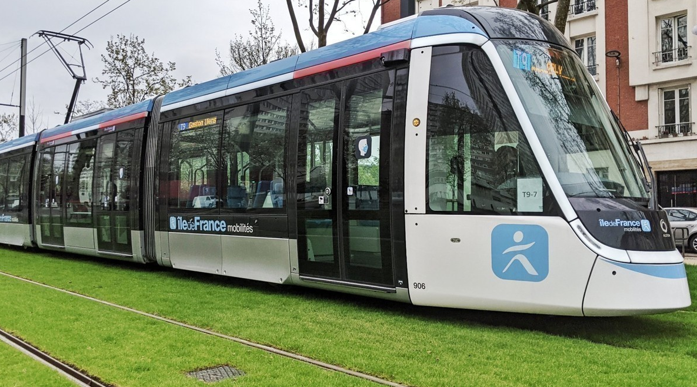
03
Ile-de-France Mobilités' Green Bond program

Slide 20

The Ile-de-France Mobilités framework and Green Bond issuances
03. Ile-de-France Mobilités' Green Bond program
Ile-de-France Mobilités’ framework :
4 categories of eligible assets set out in the framework :
Created in May 2021 and updated in March 2024
Île-de-France Mobilités’ updated Framework received a Second Party Opinion from S&P Global Ratings
The framework is aligned with the ICMA Green Bond principles and is aligned with the European Union Taxonomy
Renovation and renewal of surface public transport fleet
Renovation and renewal of rail rolling stock
Renovation and renewal of infrastructure enabling low carbon public transport
Improving the quality of service for mobility
5,3 billions of green bonds issued in 3 years:
Investor presentation 2024

Slide 21
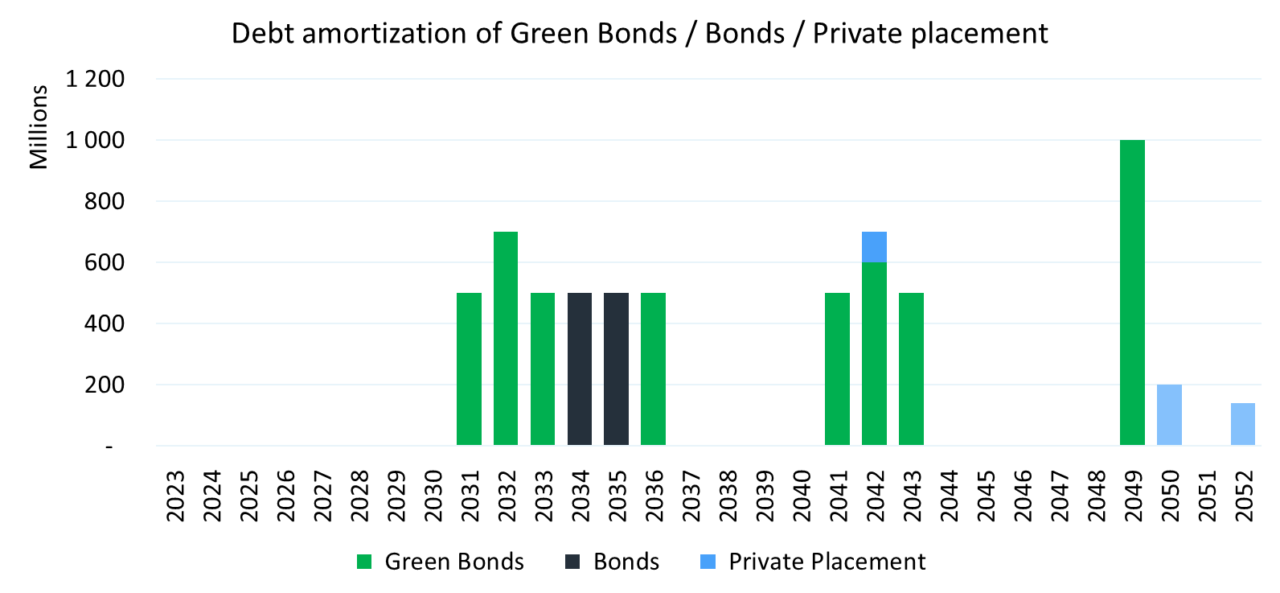
The Ile-de-France Mobilités framework and Green Bond issuances
03. Ile-de-France Mobilités' Green Bond program
Ile-de-France Mobilités’ Green Bond issuances : 5,3 bn € of green bond issued in 3 years with an average duration of 17 years
Investor presentation 2024

Slide 22
03. Ile-de-France Mobilités' Green Bond program
The Ile-de-France Mobilités framework and Green Bond issuances
Between 2024 and 2033 Ile de France Mobilités will invest more than 38 billion euros in the Ile de France region’s public transport network and plans to raise 24 billion euros of debt in this period to finance this investment plan, the majority of which will be in the form of Green Bonds (70% to 80%)
Investor presentation 2024
Notes:
These debt projections relied on the following main hypothesis :
A volume increase of 2.1% per year of transport tax (average annual change 2020 – 2025)
Revenue dynamics enabling notably new offerings financing (excluding Grand Paris Express)
Complementary revenues to finance Grand Paris Express. Taking into account the future evolution of the network’s scope, an evolution of IDFM’s revenue structure is appropriate. Negotiations are underway between IDFM and the State
IDFM plans to finance itself through various sources including :
EMTN Program issuances, public and private,
EIB,
private placements, like NSV or SSD,
bank funding.

Slide 23
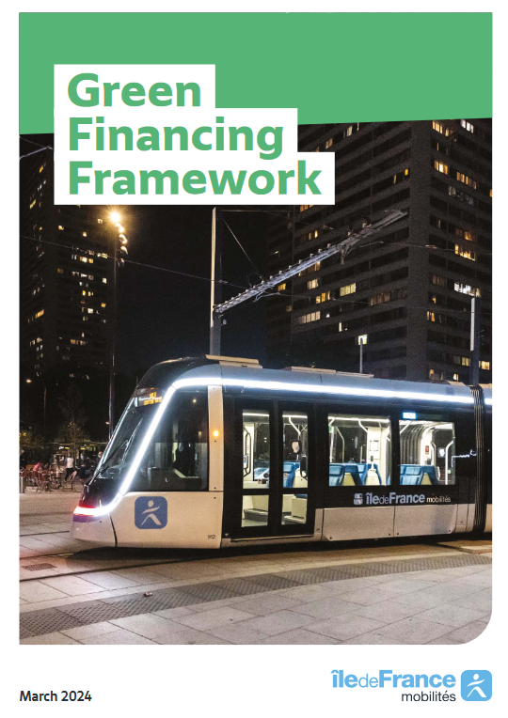
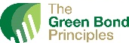


Overview of the New Green Financing Framework
03. Ile-de-France Mobilités' Green Bond program
In March 2024, Île-de-France Mobilités published an updated Green Financing Framework in order to be aligned with best market practices and recent market evolutions.
This Framework has been developed in alignment with the International Capital Markets Association (“ICMA”) Green Bond Principles of June 2021, with June 2022 Appendix 1
The proceeds of the Green Bonds will contribute to the following EU environmental objective: Climate Change Mitigation
All the following sub-categories are considered to be included in the ICMA Green Bond Principles Project Category “Clean Transportation”
    Main evolutions
Full EU Taxonomy alignment
Île-de-France Mobilités has strengthened the eligibility criteria of the Use of Proceeds categories of the Framework, using the EU Taxonomy Technical Screening Criteria
Extension of the Framework to include Green NeuCP
Île-de-France Mobilités expanded its original Green Bond Framework as a Green Financing Framework in order to include Green NeuCP
Île-de-France Mobilités’ updated Framework received a Second Party Opinion from S&P Global Ratings
    Other evolutions
Inclusion of additional eligible projects in the existing Use of Proceeds categories – incl. aerial cableways.
Improved transparency and reporting efforts, as well as strengthened ESG risk management and project evaluation & selection processes
Reduction of the look-back period from 36 months to 24 months
Investor presentation 2024

Slide 24



Focus on the Use of Proceeds
03. Ile-de-France Mobilités' Green Bond program
An amount equal to the net proceeds of the green bonds will be used exclusively to finance and re-finance, in whole or in part, “Eligible Green Projects” meeting eligibility criteria aligned with the requirements of the EU Taxonomy Delegated Acts on climate change mitigation.
All the following sub-categories are considered to be included in the ICMA Green Bond Principles Project Category “Clean Transportation”.
Île-de-France Mobilités’ Eligible Green Projects will contribute to three Sustainable Development Goals, as defined by the United Nations
Eligible Green sub-categories | Description | EU Taxonomy mapping | NACE codes
1 - Renovation and renewal of urban, suburban and road passenger transport such as bus network or aerial cableways | Acquisition for the expansion of the bus fleet or the renewal of buses with 0 direct (tailpipe) CO₂ emissions Acquisition of aerial cableways with 0 direct (tailpipe) CO₂ emissions | 6.3. Urban, suburban and road passenger transport | 49.31
2 - Renovation and renewal of public rail transport rolling stock (train, metro, tram train, tramway) | Acquisition & renovation of carriages and equipment for electrified rail transport with 0 direct (tailpipe) CO₂ emissions. This includes trains, metros, tram-trains, tramways | 6.1. Passenger interurban rail transport 6.3. Urban, suburban and road passenger transport | 49.10 49.31
3 - Renovation and renewal of infrastructure enabling low-carbon public transport | Acquisition, Construction or Renovation of infrastructure and installations dedicated to urban and suburban public passenger transport or the vehicles with zero tailpipe CO₂ emissions, including associated signaling systems for metro, bus, tram, and rail systems | 6.15. Infrastructure enabling low-carbon road transport and public transport | F 52.21 F 42.12
4 - Improving the quality of service for mobility | Expenditures aimed at improving the quality and accessibility of low-carbon public transport, including: > Improvement of passenger information > Improvement of the ticketing system > Improvement of accessibility (e.g., for people with reduced mobility) > Acquisition of electrically assisted bicycles and subsidies to individuals for the purchase of Véligo electrically assisted bicycles | 6.4. Operation of personal mobility devices 6.15. Infrastructure enabling low-carbon road transport and public transport | F 52.21 F 42.12 F 77.21
NEW
NEW
Investor presentation 2024

Slide 25
A Framework Fully aligned with the EU Taxonomy
03. Ile-de-France Mobilités' Green Bond program
Île-de-France Mobilités carried out an assessment of the EU taxonomy requirements. Île-de-France Mobilités’ Framework is fully aligned with the Substantial Contribution Criteria, the Do No Significant Harm Criteria and the Minimum Social Safeguards of the EU Taxonomy.
This alignment has been confirmed by S&P in the SPO.
Alignment with the Substantial Contribution Criteria is ensured thanks to the alignment of the eligibility criteria defined under the Use of Proceeds section with the criteria of the EU Taxonomy.
The alignment with the DNSH criteria is reached through a dual approach: Île-de-France Mobilités has used adherence to European, National and Regional regulations or plans as well as specific policies and processes of Île-de-France Mobilités to demonstrate full compliance with the DNSH criteria.
Île-de-France Mobilités has processes in place to ensure that transport operators meet the Minimum Social Safeguards. French law stipulates that public contracts may not be awarded to economic operators that have been found guilty of fraud, corruption, or the trafficking or exploitation of human beings. As a public-sector entity, Île-de-France Mobilités is also subject to local regulations to ensure the respect of human and labor rights. It also has to meet specific processes that favor compliance with corruption, taxation, and fair competition requirements.
Overview of the EU Taxonomy approach
EU Taxonomy activity | Green Financing Framework categories | Substantial Contribution Criteria | Do No Significant Harm | Minimum Social Safeguards |  | Full Alignment
6.1 Passenger interurban rail transport | 2
6.3. Urban, suburban and road passenger transport | 1 ; 2
6.4. Operation of personal mobility devices | 4
6.15. Infrastructure enabling low-carbon road transport and public transport | 3 ; 4
Focus on the DNSH Pollution criteria for Prevention and control
under EU Taxonomy activity – 6.3. Urban, suburban and road passenger transport
Bus operators have been asked by Île-de-France Mobilités to use the reference database named EPREL to identify the two highest classes for rolling resistance (influencing energy efficiency) of tyres. Only electrics buses which meet this technical screening criteria will be considered eligible under this Framework. Île-de-France Mobilités contemplates implementing this criteria systematically in procurement processes. Concerning aerial cableways, Île-de-France Mobilités confirms that it does not qualify as road vehicle of any category – hence this criteria is not relevant.
Investor presentation 2024

Slide 26
Focus on the Green Neu CP
03. Ile-de-France Mobilités' Green Bond program
Île-de-France Mobilités has been the first public local entity to issue Green NeuCP in France (with the official Banque de France template).
With this Framework update, Île-de-France Mobilités has made the choice to broaden the scope of the potential green financing instruments issued in order to include Green NeuCP.
The purpose of this green NeuCP programme is to finance or re-finance short-term expenses i.e. operating costs under contracts with public transport operators such as SNCF in the Île-de-France region. All the expenditures financed or re-financed by this Green NEU CP programme are also aligned with the use of proceeds requirements set forth in the Framework.
Given the short time nature of these products, Île-de-France Mobilités has put in place a dedicated process for the reporting related to Green NeuCP. Île-de-France Mobilités commits to publishing allocation of proceeds and impact reports annually, with a section dedicated to Green NeuCP. With respect to the Green NEU CP, Île-de-France Mobilités intends to report the following indicators:
CO₂ emissions per passenger km travelled (gCO₂eq /pass.km)
Volume of socially responsible purchases from inclusion enterprises and sheltered sector enterprises
Share of purchases from SMEs in the Region Île-de-France
Number of energy meters installed
% of material recovery in dismantling rolling stock
Number of units dismantled
Investor presentation 2024

Slide 27

Positive SPO from S&P
03. Ile-de-France Mobilités' Green Bond program
Second Party Opinion on the updated Green Financing Framework
Île-de-France Mobilités’ updated Framework received a Second Party Opinion from S&P Global Ratings confirming:
The Framework alignment with the ICMA Green Bond Principles
The quality of the Use of Proceeds categories, attributing a “Dark Green” assessment for all categories
The alignment of the Framework with the EU Taxonomy
No weakness has been identified in the Framework by S&P
All categories have obtained the highest assessment
Strengths identified by S&P
Electric rail transport is generally considered climate friendly and zero tailpipe emissions are essential to meeting 2050 climate goals (this represents most issuances proceeds). Other eligible projects also have strong environmental benefits. The accessibility projects help address the most material social sustainability factor.
Environmental requirements for the various suppliers and contractors is considered to be a strength.
EU Taxonomy activity | S&P Assessment
1 - Renovation and renewal of surface public | Dark green
2 - Renovation and renewal of public rail transport rolling stock (train, metro, tram train, tram) | Dark green
3 - Renovation and renewal of infrastructure enabling low-carbon public transport | Dark green
4 - Improving the quality of service for mobility | Dark green
EU Taxonomy alignment assessment
Fully aligned | Partially aligned | Not aligned
Investor presentation 2024

Slide 28
03. Ile-de-France Mobilités' Green Bond program and reporting
2024 funding program
1.8 bn€ of debt to be raised in 2024.
1.5 bn€ already raised in March and September (15 year)
Between 2.2 and 2.7 of debt to be raised in 2025.
NEWS : IDFM issued it’s first Green NeuCP for 500 M€ in october 2022, making it the first public local entity to issue Green NeuCP in France (within the banque de France official template)
2025 funding program
Investor presentation 2024

Slide 29
Contacts for any question :
aine.omahony@iledefrance-mobilites.fr, Green finance manager
christophe.chabenet@iledefrance-mobilites.fr, Debt and treasury manager
thomas.stouf@iledefrance-mobilites.fr, Head of the funding division
https://www.iledefrance-mobilites.fr/

Slide 30
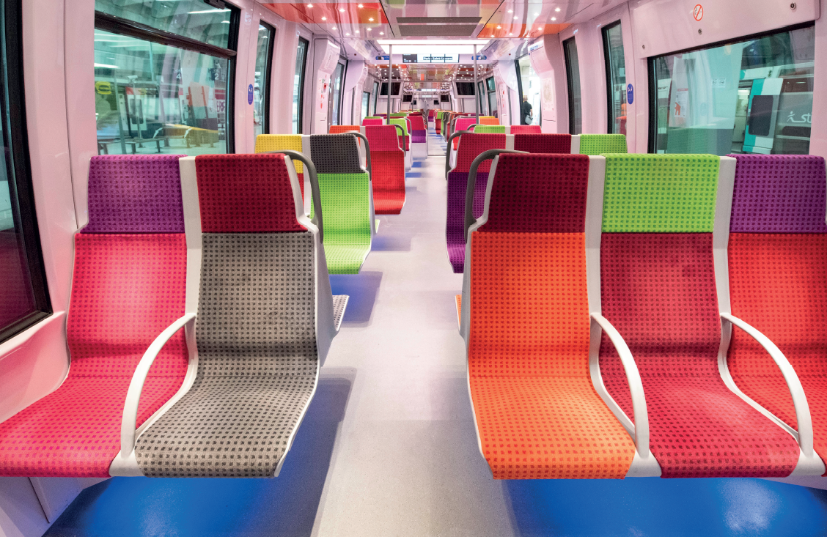
APPENDIX

Slide 31
Appendix 1 – Ile-de-France Mobilités’ budget : similar rules to those of local authorities
Expenditures
Revenues
Operational costs – fare revenues (cashed directly by operators)
Transport tax
Running
Other expenses
Statutory contributions and subsidies
Financial fees
Gross savings = self-financing
Other revenues
Debt principal repayment
Gross savings = self-financing
Investment
Equipment expenses
Revenues from parking fines
Other revenues
Borrowings
Investor presentation 2024
Notes:
slide 13 presents Ile-de-France Mobilités budget structure.
As a public local administration, IDFM must respect financial rules :it is not able to approve an unbalanced budget or be in a « bankruptcy » position
Our budget is composed of 2 sections :
an operating section, as you can see in the upper part of the slide, dedicated to running costs and revenues. Until 2019 fare revenues do not appear in IDFM budget, as they are perceived directly by operators.
an investment section, bearing all new investments and debt.
As for all other local authorities as Region or departement, the operating section must generate a budget suplus, in order to finance the investment section :
In priority to cover the debt principal repayment
Ideally to cover a part of equipment expenses, which in the case of IDFM are mainly composed of rolling stock
The budget surplus generated by the operating section (restated of provisions and amortisations) is then called gross savings and will be used to calculate certain ratios.

Slide 32
Appendix 2 - Status and Financial rules
Ile-de-France Mobilités is subject to budgetary control of its actions by Ile-de-France’s prefect and by the “Chambre Régionale des Comptes” (art. L.1241-12 of the Transport Code). Conditions stated in the local authority’s general code (CGCT) and financial jurisdictions code (CJF) apply. These rules cover the following points:
Adoption date, transmission and real budget balance (CGCT Articles L. 1612-2 and L. 1612-8 and L. 1612-4 and L. 1612-5) ;
Dating vote, balance and administrative account’s eventual rejection (CGCT Articles L. 1612-12 à L. 1612-14) ;
Enrolment and execution of compulsory expenses (CGCT articles L. 1612-15 and L. 1612-16).
These rules ensure that Ile-de-France Mobilités is not able to approve an unbalanced budget or be in a « bankruptcy » position.
Applicable rule in case of imbalanced vote
The prefect invokes the “Chambre Régionale des Comptes” (regional court of auditors) as regards to the budget which was not adopted in real balance within 30 days of its transmission. It informs the interested local authority as well as its accountant, that a request has been made to the “CRC”.
If the “CRC” does not observe a real imbalance as mentioned in CGCT’s article L.1612-5, the procedure comes to a halt.
If the “CRC” observes a real imbalance, it suggests necessary correcting measures. Notification of these suggestions are made to the government official and local authority, which must in turn notify the deliberating assembly.
Budget discontinuation is led:
either by the deliberating organ basing itself on suggestions made by the “CRC”
either by the prefect as a “règlement d’office” taking shape as a ministerial order
Investor presentation 2024 - Appendix
Notes:
According to financial rules applicable to IDFM, both operating and investment sections must be balanced.
Reminder of applicable procedure in case of imbalanced vote :
Within 30 days of budget transmission, the prefect summons the Regional Court of Auditors as regards to the budget that was adopted unbalanced. It informs the local authority as well as its public accountant, that a request has been made to the “CRC”.
If the “CRC” does not confirm a real imbalance, as legally defined (CGCT’s article L.1612-5) the procedure ends.
If the “CRC” confirms a real imbalance, it suggests necessary measures: reduction or elimination of non-compulsory or essential expenses, and/or increase in revenues.
In the case of IDFM, the CRC could suggest a raise of fare revenues.
Notification of these suggestions are made to the government official and the local authority, which must in turn notify the deliberative assembly.
Balanced budget adoption is finally led:
- either by the deliberative assembly following the CRC suggestions
- either by the regional prefect whose powers entitle him/her to proceed to the budget elaboration (procedure named a “règlement d’office” via a ministerial order)

Slide 33
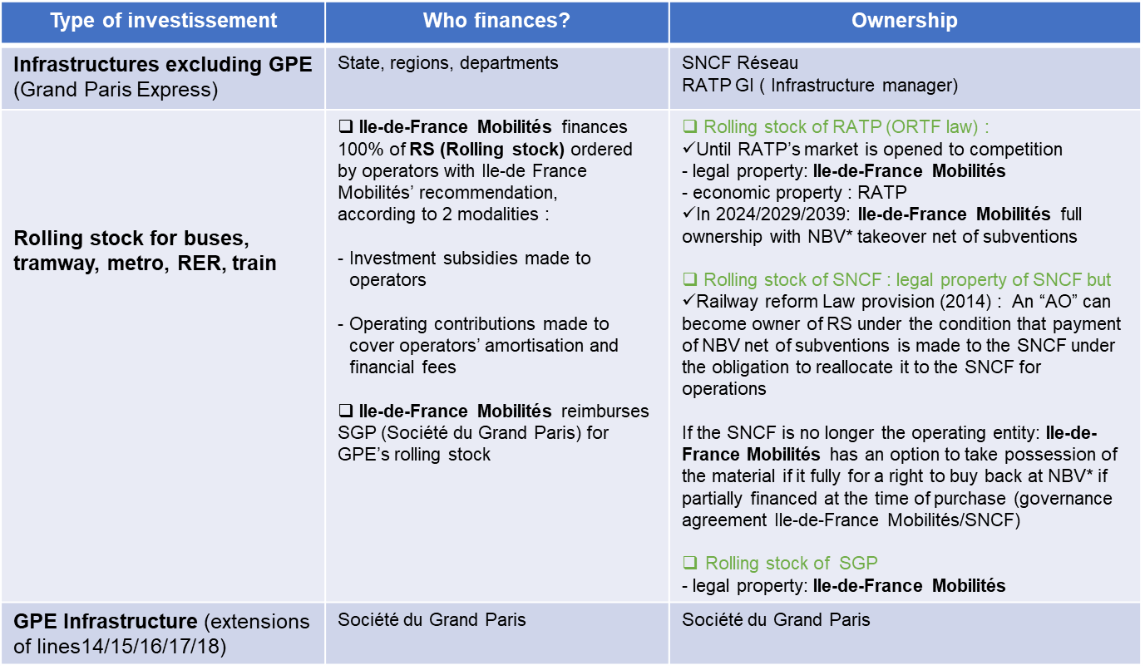
Appendix 3 - Distribution of investment financing
* NBV: Net Book Value
Investor presentation 2024 - Appendix

Slide 34
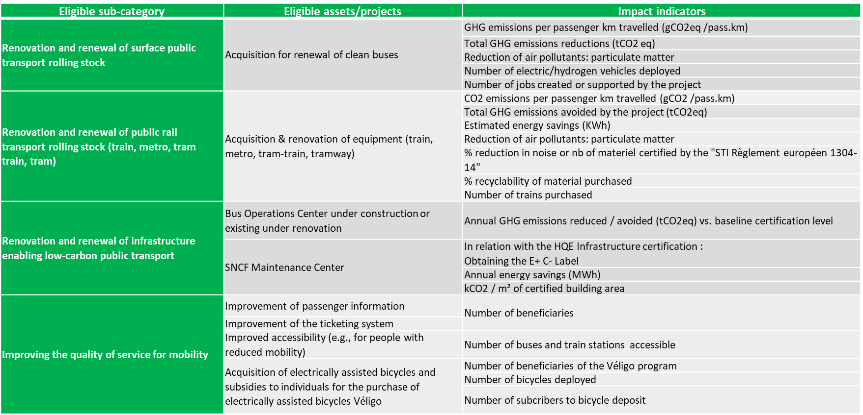
Appendix 4 - Reporting : examples of impact reporting indicators
Investor presentation 2024 - Appendix

Slide 35

Appendix 5 - How it works: financing operations
Main expenses : how IDFM/operators contracts work
The contributions payed by Ile-de-France Mobilités to operators cover the total of contractual charges (operating costs) +/- bonus and malus (on quality of service and fare revenues). Since 2020 and 2021, Ile-de-France Mobilités collects directly fare revenues
Operator operating costs
Others (advertising…)
Financial fees and amortisation
Contributions of Ile-de-France Mobilités
Operator operating revenues
Running of networks
Material and infrastructure maintenance (RATP)
Investor presentation 2024 - Appendix
Notes:
Graph 1 : As explained before, IDFM decides on fare prices. Operators currently perceive fare revenues which cover part of their exploitation costs. IDFM contributions to operators are designed to compensate the difference between operators’ charges and revenues. IDFM decides on fare prices and as a consequence, keep all the benefits from rate hikes. Operators are only interested in volumes’ evolution
IDFM is currently negociating new types of contrats with the two main operators SNCF and RATP : in the new contractual schemes IDFM will perceive directly transport fares revenues
IDFM is constantly negogiating with operators to amend the scope of contracts, as the board of executives votes for new offering. The contracts can be amended to reduce public transport offer, (as Moody’s mentioned it in its credit opinion)it offers some budgetary flexibility.

Slide 36
Disclaimer
This Presentation is being furnished to you solely for your information on a confidential basis and may not be reproduced, redistributed or passed on, in whole or in part, to any other person. This document does not constitute or form part of any solicitation, offer or invitation to purchase or subscribe for any securities issued by Île-de-France Mobilités, as described in the Presentation, and neither it nor any part of it shall form the basis of, or be relied upon in connection with, any contract or commitment whatsoever. Accordingly, it is not directed to the specific investment objectives, financial situation or particular needs of any recipient. You should consult with your own legal, regulatory, tax, business, investment, financial and accounting advisers to the extent that you deem it necessary, and make your own investment, hedging and trading decisions (including decisions regarding the suitability of an investment in Île-de-France Mobilités securities) based upon your own judgment and advice from such advisers as you deem necessary and not upon any view expressed in this document.
No representation or warranty, express or implied, is made as to, and no reliance may be placed for any purposes whatsoever on, the fairness, accuracy, completeness or correctness of the information or opinions contained herein. None of Île-de-France Mobilités , or any of its affiliates, advisers or representatives shall have any liability whatsoever (in negligence or otherwise) for any loss howsoever arising from any use of this document or its contents or otherwise arising in connection with the Presentation. Certain Statements in the Presentation are forward-looking, including Statements concerning Île-de-France Mobilités’s plans, objectives, goals, strategies, future events, future revenues or performance, capital expenditures, financing needs, plans or intentions relating to acquisitions, competitive strengths and weaknesses, business strategy and the trends Île-de-France Mobilités anticipates in the industries and the political and legal environment in which it operates and other information that is not historical information.
By their nature, forward-looking Statements involve inherent risks and uncertainties, both general and specific, and risks exist that the predictions, forecasts, projections and other forward-looking Statements will not be achieved. Île-de-France Mobilités does not make any representation, warranty or prediction that the results anticipated by such forward-looking Statements will be achieved, and such forward-looking Statements represent, in each case, only one of many possible scenarios and should not be viewed as the most likely or standard scenario. Such forward looking Statements speak only as of the date on which they are made. Any opinions expressed in the Presentation are subject to change without notice and Île-de-France Mobilités does not undertake any obligation to update or revise any forward looking Statement, whether as a result of new information, future events or otherwise.
Neither this Presentation nor any copy thereof may be retained by you or reproduced, redistributed or passed on, in whole or in part, to any other person. By attending the Presentation you agree to be bound by the foregoing restrictions. Île-de-France Mobilités shall not bear any responsibility in the case where a Recepient distributes or makes any use of this Presentation without its authorisation and without the relevant authorities’ authorisation in the relevant jurisdiction.
The distribution, reproduction or partial reproduction of this Presentation may be restricted by law or regulation in certain countries, and accordingly, this Presentation should not be distributed or reproduced, even partially, on those countries. Île-de-France Mobilités doe not represent or warrant that the securities issued by Île-de-France Mobilités will be lawfully offered in compliance with any applicable registration or other requirements in any such jurisdiction or pursuant to exemption available thereunder, and does not assume any responsibility for facilitating any offering in any such jurisdiction.
In France, the offering and sale of securities issued by Île-de-France Mobilités will only be available to qualified investors : (a) providers of investment services relating to portfolio management for the account of third parties, and/or (b) qualified investors, other than individuals, all as defined in, and in accordance with, Articles L.411-1, L.411-2, and D.411-1 to D.411-3 of the French Code monétaire et financier.
The securities issued by Île-de-France Mobilités have not been and will not be registered under the U.S. Securities Act of 1933, as amended (the “Securities Act”). The securities issued by Île-de-France Mobilités may not be offered, sold or delivered, directly or indirectly, within the United States or directly or indirectly to U.S. persons except in accordance with Regultion S under the Securities Act (“Regulation S”).

Slide 37
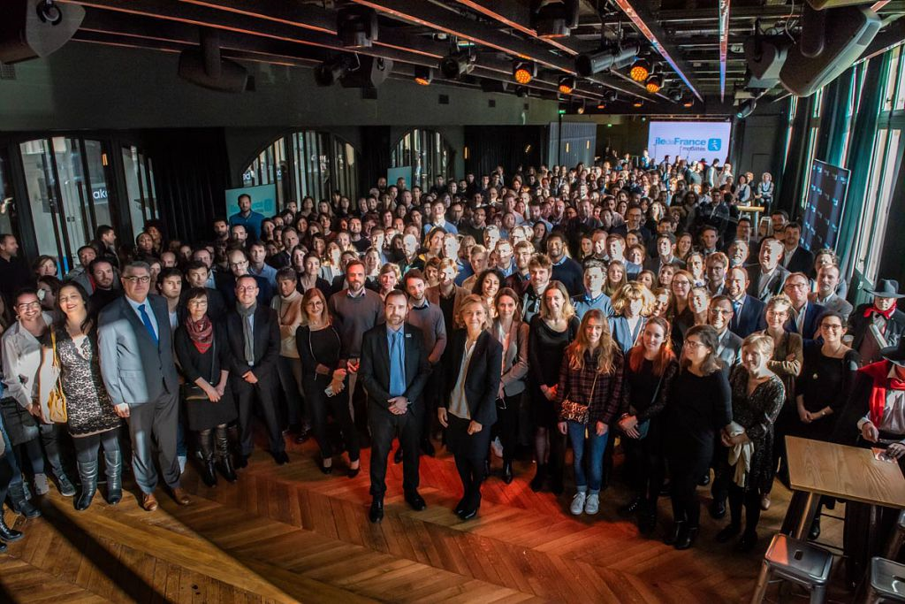
THANK YOU!

